Slide 1
Homework 2
Render To Texture

Slide 2
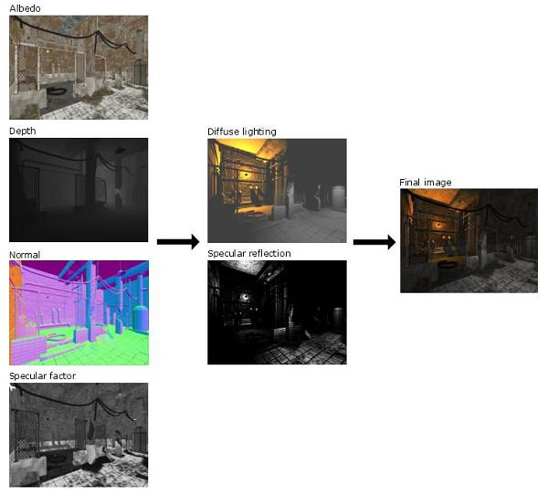
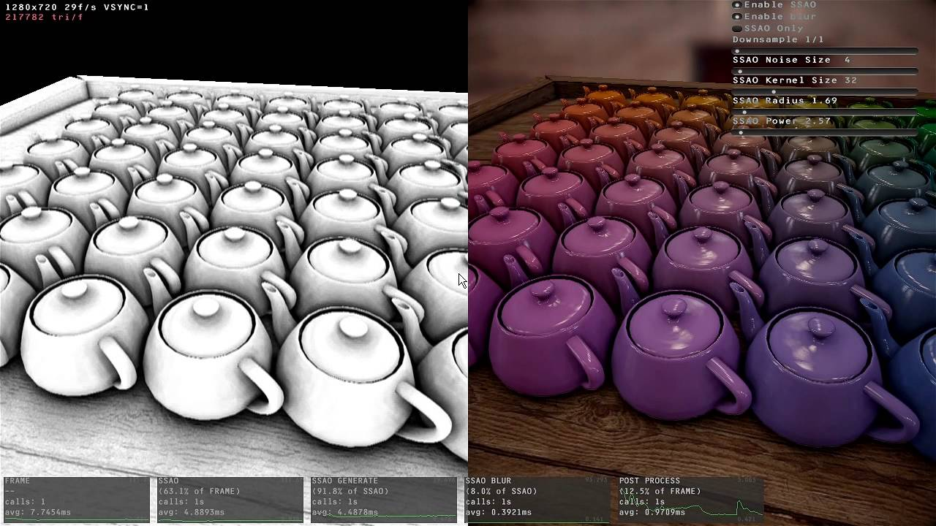
Render To Texture - Concept
Render the scene information into texture.
This textures will be used to implement various acceleration techniques and lighting effects.
Defered rendering
Screen Space Ambient Occlusion(SSAO)

Slide 3
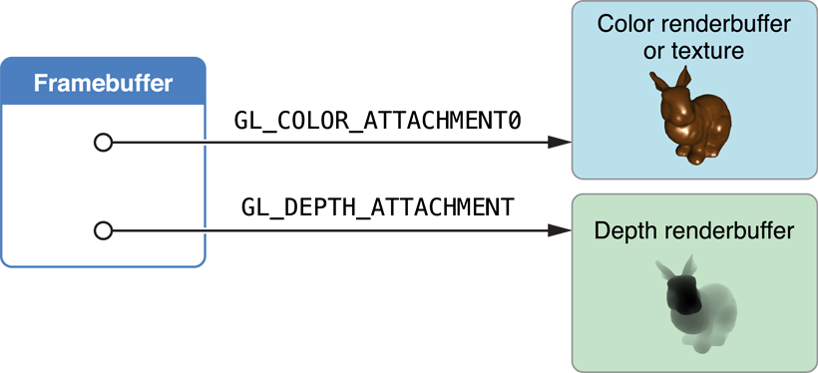
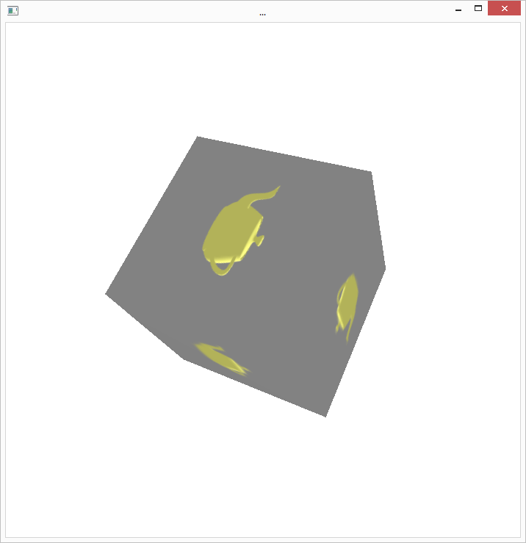
Render To Texture [100pt]
Create a simple scene with animation. [20pt]
Render the scene into a texture (texture01: color image) using FBO. [25pt]
Render the depth of the scene into another texture (texture02: grey image) using FBO. [25pt]
Create another scene with a rotating cube. Attach textures that you’ve created above on the faces of the cube. [30pt]
Let’s say cube has faces {f1...f6}.
Apply texture01 to {f1, f3, f5}.
Apply texture02 to {f2, f4, f6}.
Use FBO you’ve made in previous step to implement this part.
Due date 2017/04/24

